Slide 1
DATA STORAGE
Lecture slides are adapted/modified from slides provided by the textbook, Computer Science: An Overview by J. Glenn Brookshear and Dennis Brylow
publisher Pearson

Slide 2
Data Storage
Bits and Their Storage
Main Memory
Representing Information as Bit Patterns
The Binary System
Storing Integers
Storing Fractions
Data Compression
Communications Errors
Mass Storage

Slide 3
Bits and Bit Patterns
Bit: Binary Digit (0 or 1)
Bit Patterns are used to represent information.
Numbers
Text characters
Images
Sound
And others

Slide 4
Boolean Operations
Boolean Operation: An operation that manipulates one or more true/false values
Specific operations
AND
OR
XOR (exclusive or)
NOT

Slide 5
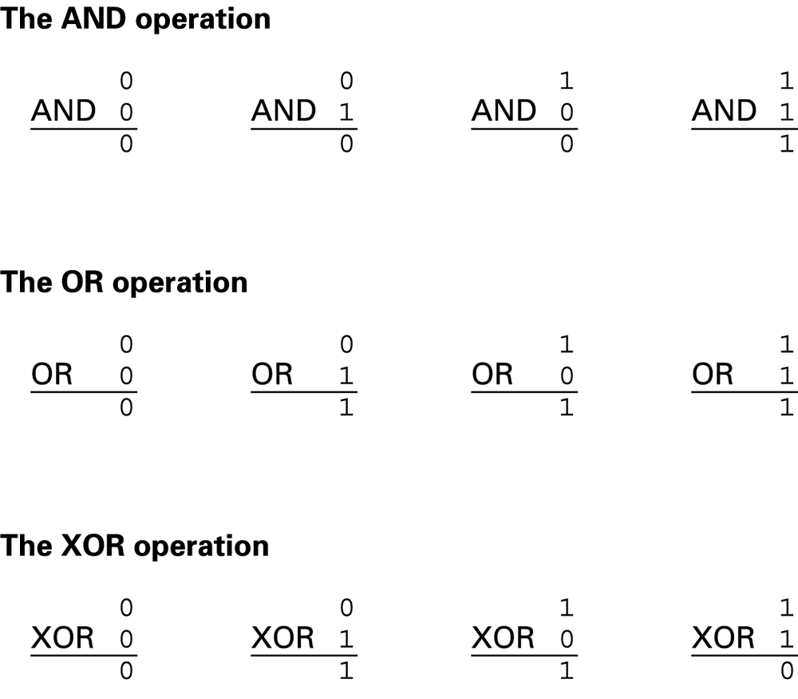
Boolean Operations

Slide 6
Gates
Gate: A device that computes a Boolean operation
Often implemented as (small) electronic circuits
Provide the building blocks from which computers are constructed
VLSI (Very Large Scale Integration)

Slide 7
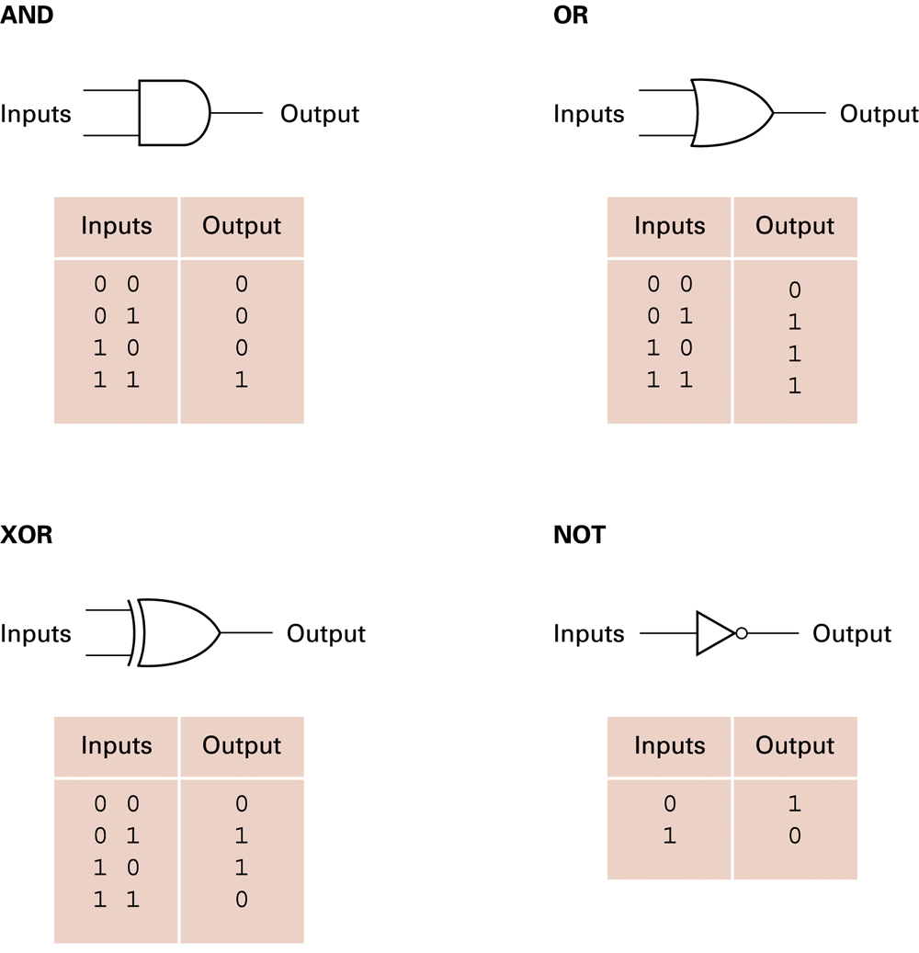
A pictorial representation of gates

Slide 8
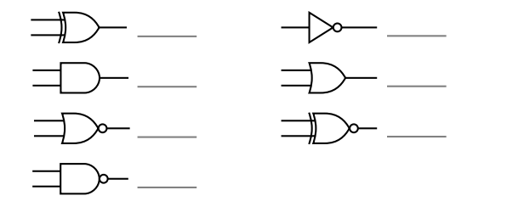
Quiz
What are the names of these gates?

Slide 9
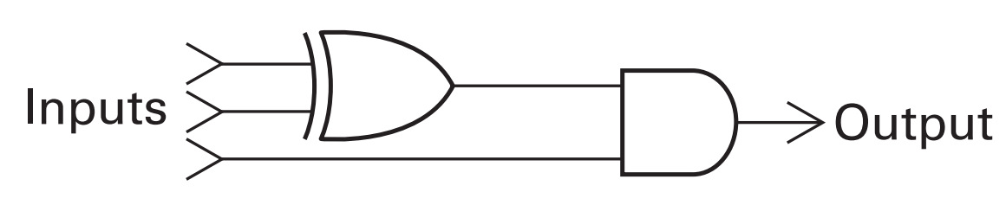
Quiz
What input bit patterns will cause the following circuit to produce output of 1?

Slide 10
Flip-flops
Flip-flop: A circuit built from gates that can store one bit.
One input line is used to set its stored value to 1
One input line is used to set its stored value to 0
While both input lines are 0, the most recently stored value is preserved

Slide 11
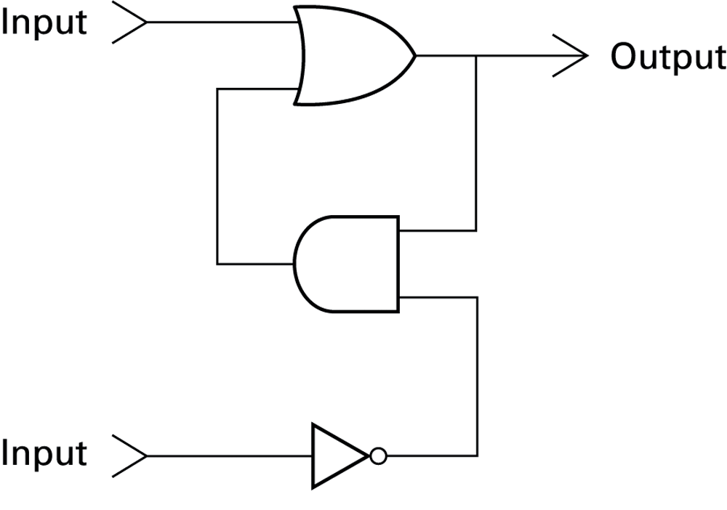
A simple flip-flop circuit

Slide 12
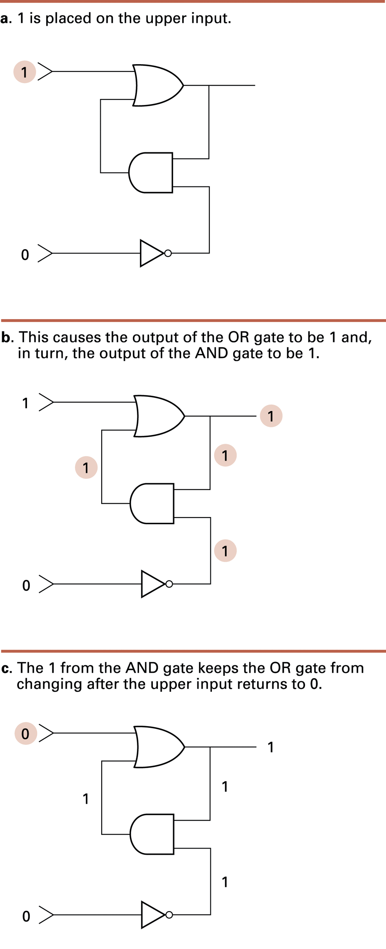
Setting the output of a flip-flop to 1

Slide 13
Setting the output of a flip-flop to 1

Slide 14
Setting the output of a flip-flop to 1

Slide 15
Quiz
Placing a 1 on the lower input of the flip-flop. What will happen at the output?

Slide 16
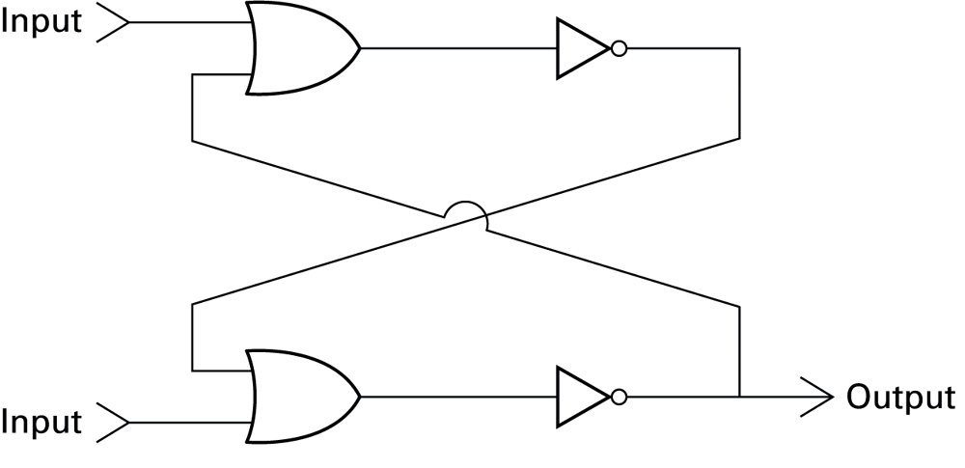
Another flip-flop

Slide 17
Quiz
If upper input is 1 and lower input is 0, what is the output?

Slide 18
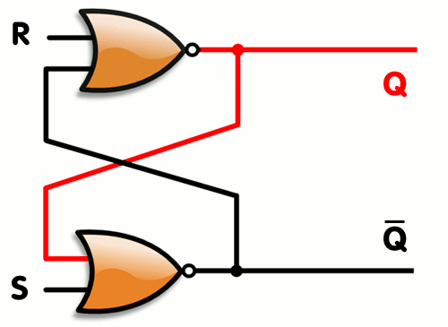
Quiz
Notes:
S R Qnext
0 0 hold state
1 0 1
0 1 0
1 1 X

Slide 19
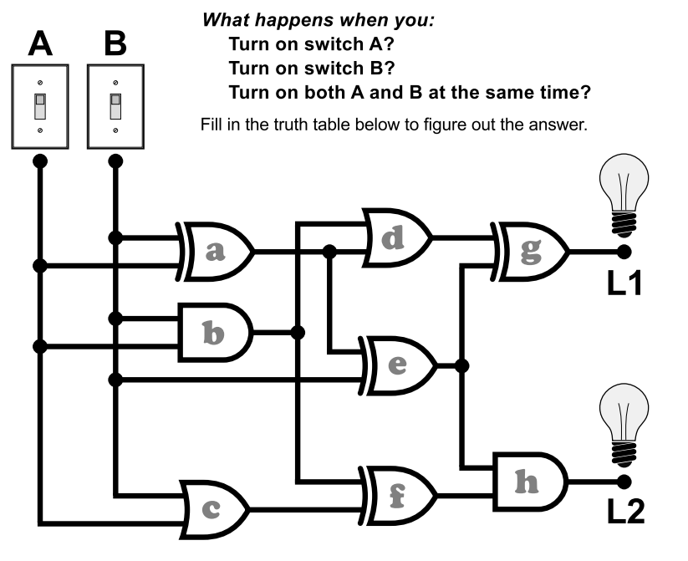
Activity

Slide 20
Hexadecimal Notation
Hexadecimal notation: A shorthand notation for long bit patterns
Divides a pattern into groups of four bits each
Represents each group by a single symbol
Example: 10100011 becomes A3

Slide 21
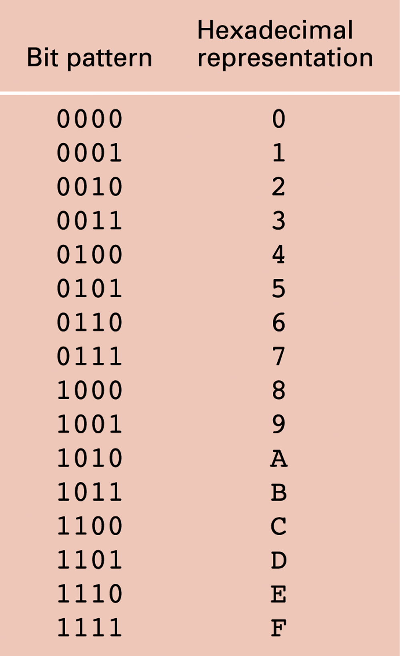
The hexadecimal coding system

Slide 22
Quiz
What bit patterns are represented by the following hexadecimal patterns?
5FD97
610A
ABCD
0100

Slide 23
Main Memory

Slide 24
Main Memory Cells
Cell: A unit of main memory (typically 8 bits which is one byte)
Most significant bit: the bit at the left (high-order) end of the conceptual row of bits in a memory cell
Least significant bit: the bit at the right (low-order) end of the conceptual row of bits in a memory cell

Slide 25
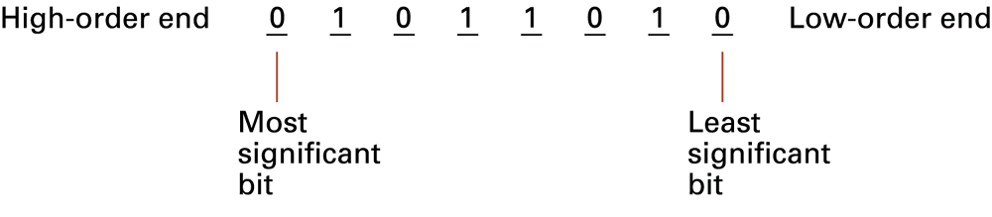
The organization of a byte-size memory cell

Slide 26
Main Memory Addresses
Address: A “name” that uniquely identifies one cell in the computer’s main memory
The names are actually numbers.
These numbers are assigned consecutively starting at zero.
Numbering the cells in this manner associates an order with the memory cells.

Slide 27
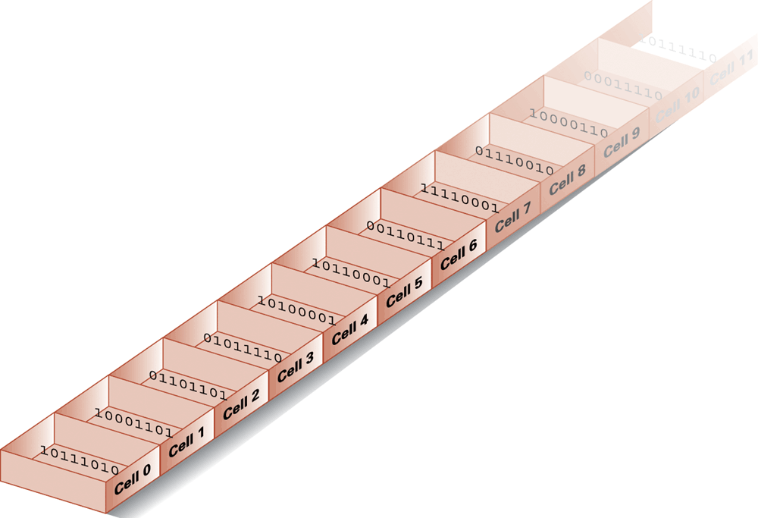
Memory cells arranged by address

Slide 28
Memory Terminology
Random Access Memory (RAM): Memory in which individual cells can be easily accessed in any order
Dynamic Memory (DRAM): RAM composed of volatile memory

Slide 29
Measuring Memory Capacity
Kilobyte: 210 bytes = 1024 bytes
Example: 3 KB = 3 times1024 bytes
Megabyte: 220 bytes = 1,048,576 bytes
Example: 3 MB = 3 times 1,048,576 bytes
Gigabyte: 230 bytes = 1,073,741,824 bytes
Example: 3 GB = 3 times 1,073,741,824 bytes
Terabyte
Petabyte
Exabyte
Kibi-, Mebi-, Gibi-,..

Slide 30
Representing Information as Bit Patterns

Slide 31
Representing Text
Each character (letter, punctuation, etc.) is assigned a unique bit pattern.
ASCII: Uses patterns of 7-bits to represent most symbols used in written English text
ISO developed a number of 8 bit extensions to ASCII, each designed to accommodate a major language group
Unicode: Uses patterns of 16-bits to represent the major symbols used in languages world wide (UTF-8, UTF-16,…)
Notes:
ASCII : American Standard Code for Information Interchange
ANSI: American National Standards Institute
UTF: Unicode Transformation Format 8-bit

Slide 32
The message “Hello.” in ASCII

Slide 33
Representing Numeric Values
Binary notation: Uses bits to represent a number in base two
Limitations of computer representations of numeric values
Overflow: occurs when a value is too big to be represented
Truncation: occurs when a value cannot be represented accurately

Slide 34
Representing Images
Bit map techniques
Pixel: short for “picture element”
RGB
Luminance and chrominance
Vector techniques
Scalable
TrueType and PostScript
Notes:
Luminance: brightness (sum of green, red, blue)
Chrominance (luminance – blue, luminance –red)
TrueType: Microsoft – Apple
PostScript: Adobe Systems

Slide 35
Representing Sound
Sampling techniques
Used for high quality recordings
Records actual audio
MIDI
Used in music synthesizers
Records “musical score”
Notes:
8000 samples per second: 8000 Hz
CD: 44,100 samples per second.
16 bits, 32 bits (stereo)
MIDI: Musical Instrument Digital Interface

Slide 36
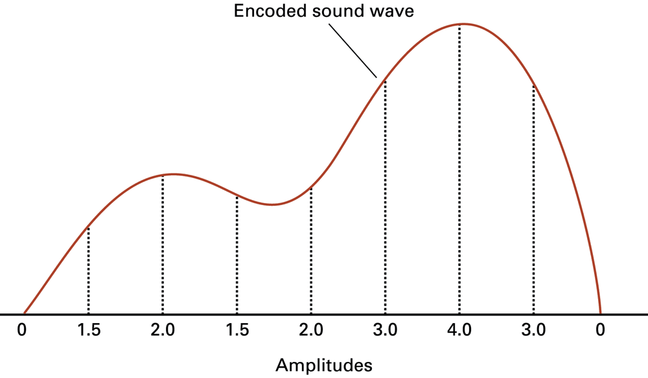
Representing Sound
The sound wave represented by the sequence 0, 1.5, 2.0, 1.5, 2.0, 3.0, 4.0, 3.0, 0

Slide 37
Quiz
Suppose a stereo recording of one hour of music is encoded using a sample rate of 44,100 samples per second as discussed.
What is the size of the encoded version?
Notes:
44100 * 4 = 176400
* 3600 = 635.040.000 bytes
~ 605 MB

Slide 38
The Binary System

Slide 39
The Binary System
The traditional decimal system is based on powers of ten.
The Binary system is based on powers of two.

Slide 40
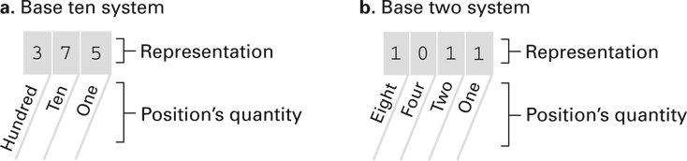
The base ten and binary systems

Slide 41
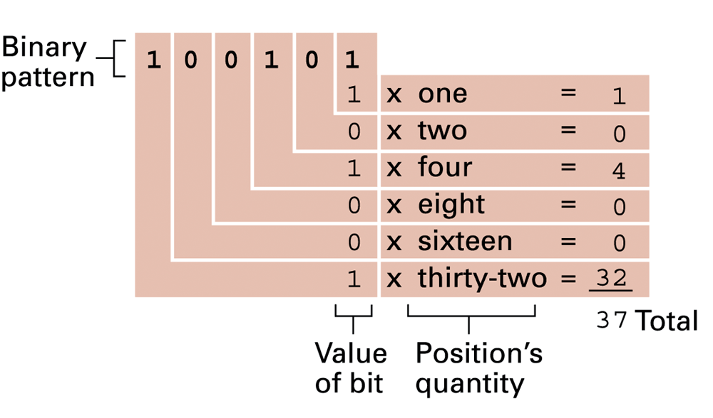
Decoding the binary representation 100101

Slide 42
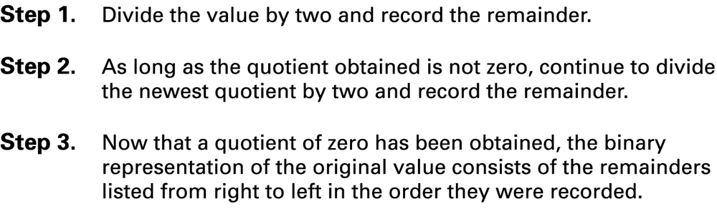
Algorithm for finding the binary representation of a positive integer

Slide 43
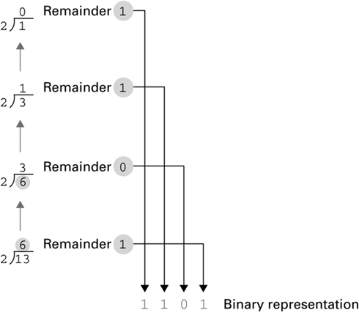
Applying the algorithm

Slide 44
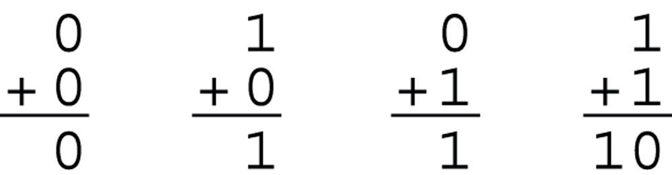
The binary addition facts

Slide 45
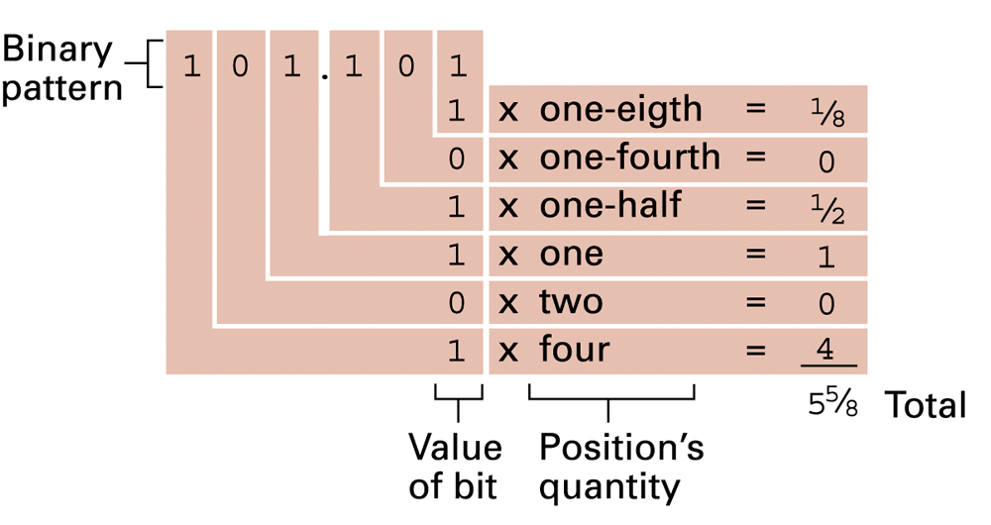
Decoding the binary representation

Slide 46
Quiz
Convert each of the following base 10 representations to its equivalent binary form:
32
15
27
53

Slide 47
Quiz
Convert each of the following binary representations to its equivalent base 10 form:
11.01
101.111
10.1
110.011
0.101

Slide 48
Quiz
Express the following values in binary notation:

Slide 49
Storing Integers
Notes:
https://www3.ntu.edu.sg/home/ehchua/programming/java/datarepresentation.html

Slide 50
Storing Integers
Two’s complement notation: The most popular means of representing integer values
Excess notation: Another means of representing integer values
Both can suffer from overflow errors.

Slide 51
Two’s complement notation systems
leftmost bit: sign bit
Complement: changing all the 0s to 1s, all the 1s to 0s.
0110 and 1001 are complements.

Slide 52
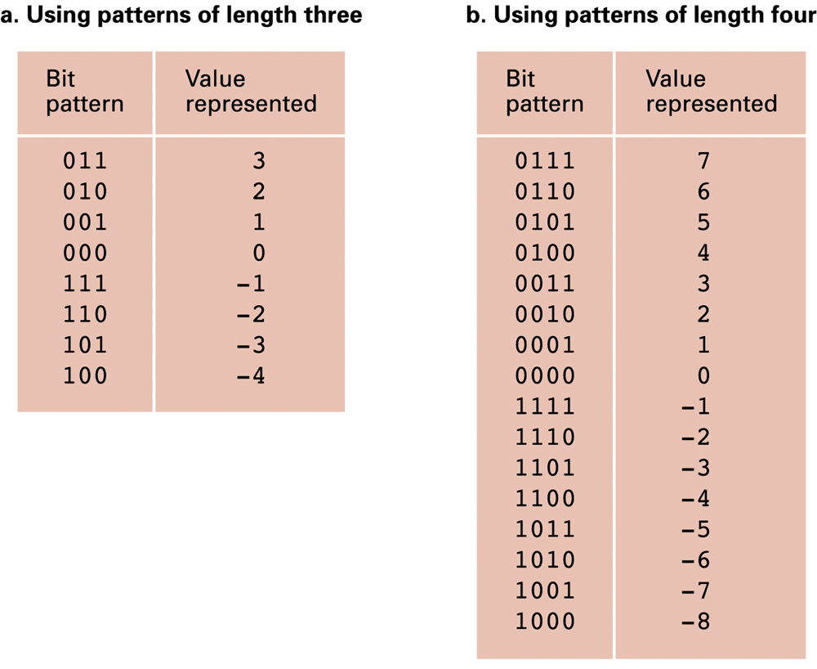
Two’s complement notation systems
Notes:
The remaining n-1 bits represents the magnitude of the integer, as follows:for positive integers, the absolute value of the integer is equal to "the magnitude of the (n-1)-bit binary pattern".
for negative integers, the absolute value of the integer is equal to "the magnitude of the complement of the (n-1)-bit binary pattern plus one" (hence called 2's complement).

Slide 53
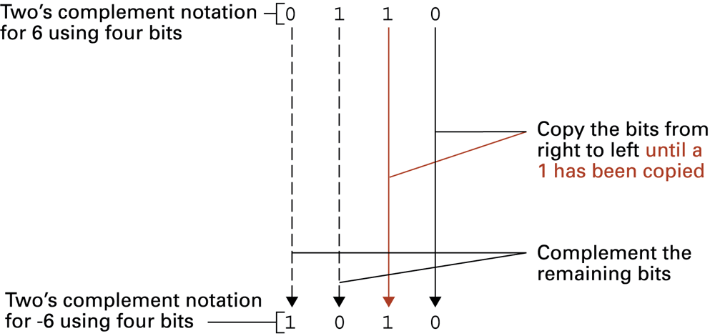
Coding the value -6 in two’s complement notation using four bits

Slide 54
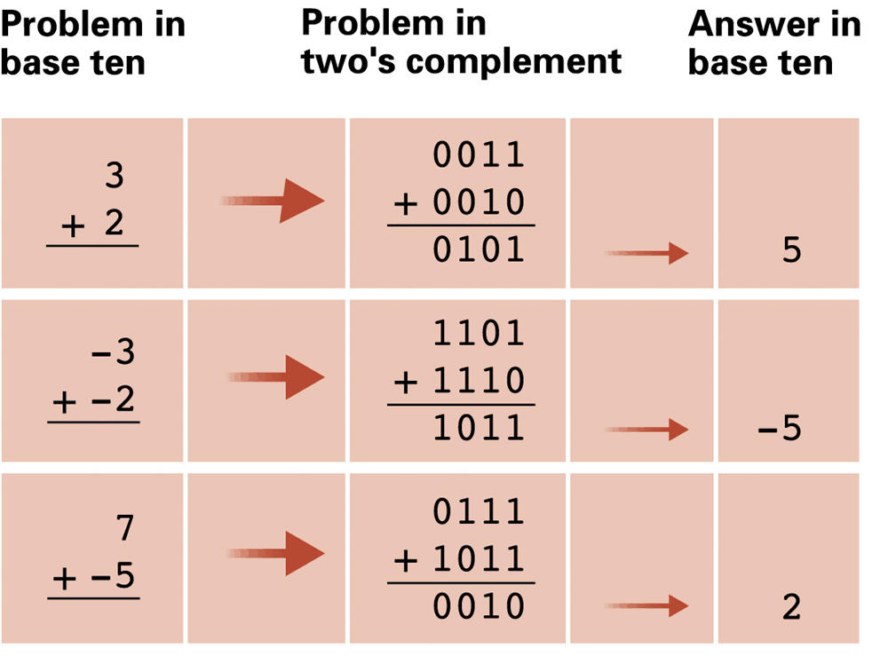
Addition problems converted to two’s complement notation

Slide 55
Quiz
Convert each of the following two’s complement representations to its equivalence base 10 form:
00011
01111
11100
11010
00000
10000
Notes:
00011 : 3
01111 : 16
11100: -4
11010: -6
10000: -16

Slide 56
Quiz
Convert to two’s complement form using patterns of 8 bits:
6
-6
-17
13
-1
0

Slide 57
Quiz
What are the largest and smallest numbers that can be stored if the machine uses bit patterns of the following lengths?
A. four
B. six
C. eight

Slide 58
Min and max of signed integers
n | minimum | maximum
8 | -2₇ = -128 | 2₇ - 1 = +127
16 | -2₁₅ = -32,768 | 2₁₅ - 1 = +32,767
32 | -2₃₁ = -2,147,483,648 | 2₃₁ - 1 = +2,147,483,647
64 | -2₆₃ = -9,223,372,036,854,775,808 | 2₆₃-1 = +9,223,372,036,854,775,807

Slide 59
Min and max of unsigned integers
n | Minimum | Maximum
8 | 0 | 2₈ - 1 = 255
16 | 0 | 2₁₆ - 1 = 65,535
32 | 0 | 2₃₂ -1 = 4,294,967,295
64 | 0 | 2₆₄ - 1 = 18,446,744,073,709,551,615

Slide 60
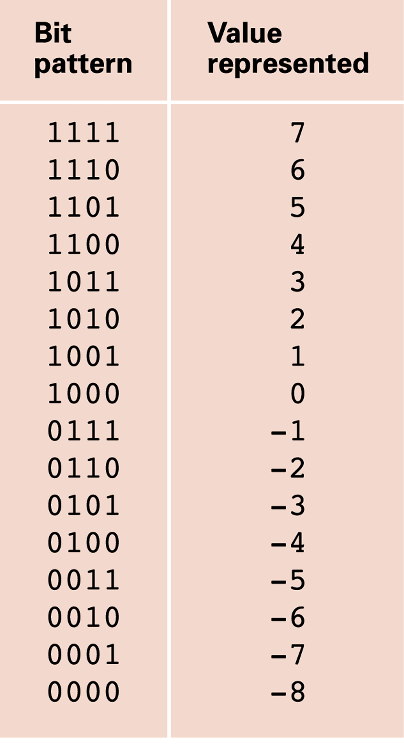
An excess eight conversion table

Slide 61
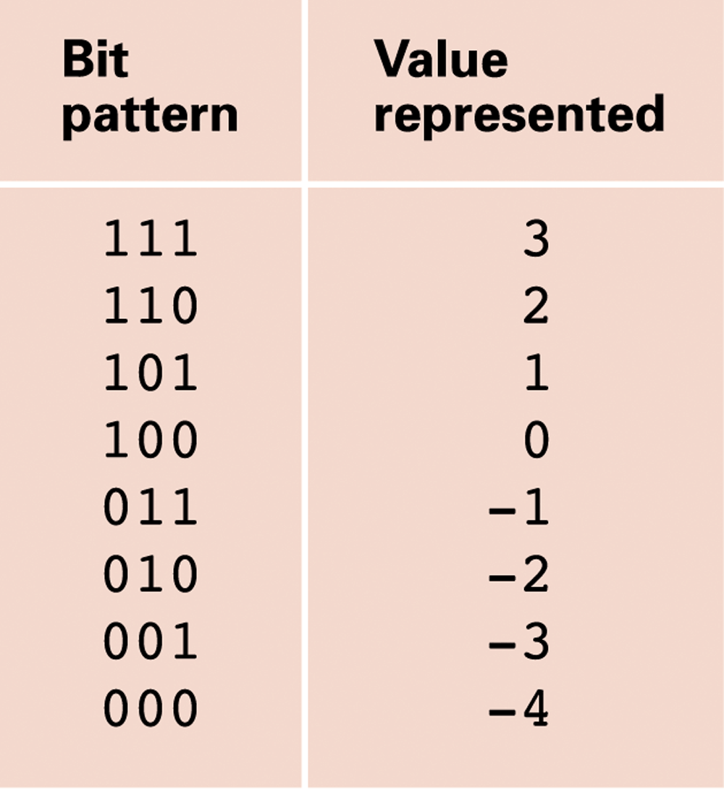
An excess notation system using bit patterns of length three

Slide 62
Storing Fractions

Slide 63
Storing Fractions
Floating-point Notation: Consists of a sign bit, a mantissa field, and an exponent field.
Mantissa: also fraction/significand
Related topics include
Normalized form
Truncation errors
Notes:
Mantissa: định trị
Exponent: mũ

Slide 64
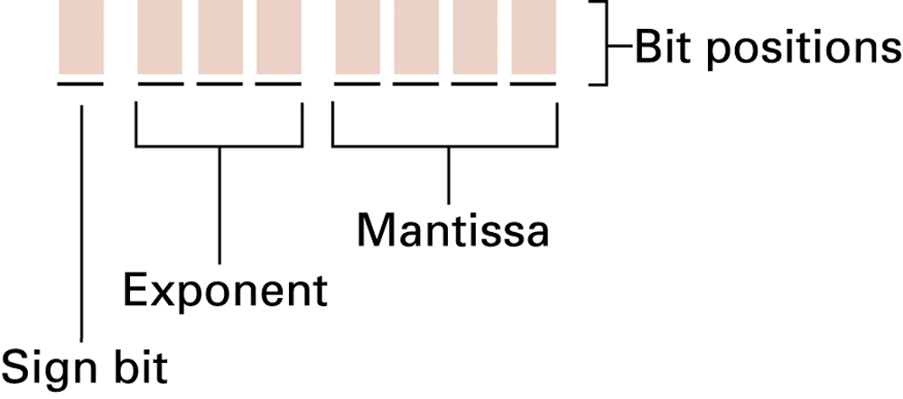
Floating-point notation components
Notes:
Mantissa: định trị

Slide 65
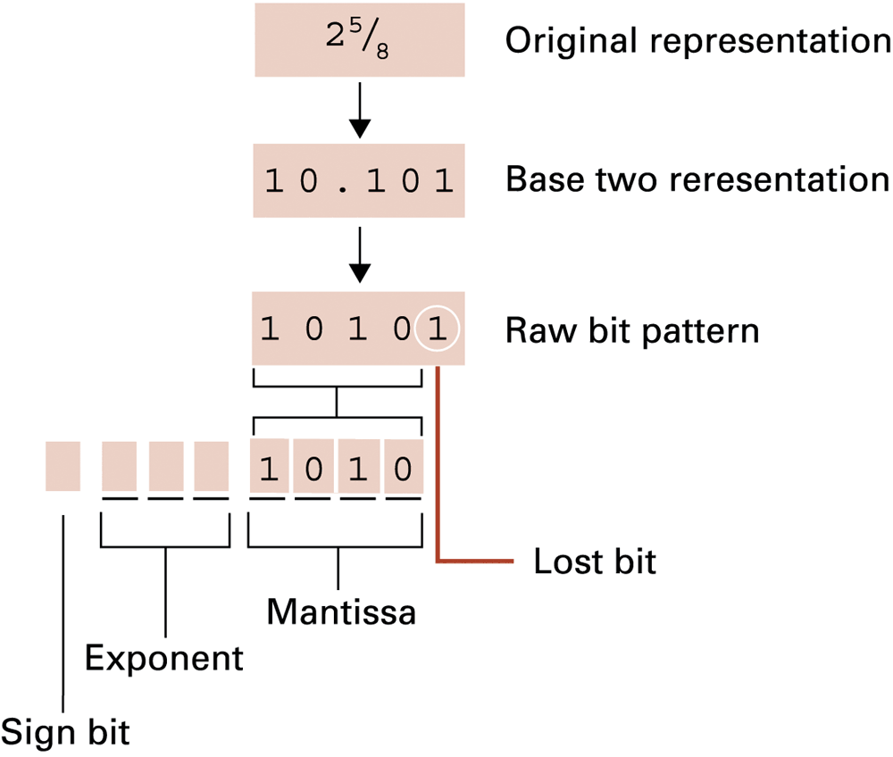
Encoding the value 2 5⁄8

Slide 66
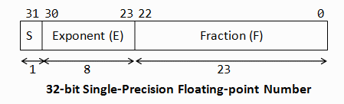
IEEE-754 32-bit Single-Precision Floating-Point Numbers
Exponent: excess-127 (bias-127)
Fraction: implicit leading bit (before radix point).
N = (-1)^S x 1.F x 2^(E-127)

Slide 67
IEEE-754 32-bit Single-Precision Floating-Point Numbers
Suppose that IEEE-754 32-bit floating-point representation pattern is 0 10000000 110 0000 0000 0000 0000 0000.
Sign bit S = 0 ⇒ positive number
E = 1000 0000B = 128D
Fraction is 1.11B (with an implicit leading 1) = 1 + 1×2^-1 + 1×2^-2 = 1.75D
The number is +1.75 × 2^(128-127) = +3.5D

Slide 68
IEEE-754 32-bit Single-Precision Floating-Point Numbers
Suppose that IEEE-754 32-bit floating-point representation pattern is 1 01111110 100 0000 0000 0000 0000 0000.
Sign bit S = 1 ⇒ negative number
E = 0111 1110B = 126D
Fraction is 1.1B (with an implicit leading 1) = 1 + 2^-1 = 1.5D
The number is -1.5 × 2^(126-127)=-0.75D

Slide 69
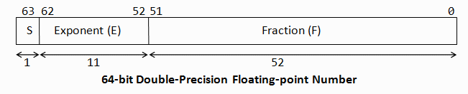
IEEE-754 64-bit Double-Precision Floating-Point Numbers
Exponent: excess-1023
Fraction: implicit leading bit (before radix point).
N = (-1)^S x 1.F x 2^(E-1023)

Slide 70
Min and Max of Floating-Point Numbers
Precision | Min | Max
Single | 1.1754 x 10⁻³⁸ | 3.40282 x 10³⁸
Double | 2.2250 x 10⁻³⁰⁸ | 1.7976 x 10³⁰⁸

Slide 71
Data Compression

Slide 72
Data Compression
Lossy versus lossless
Run-length encoding
Frequency-dependent encoding
(Huffman codes)
Relative encoding
Dictionary encoding (Includes adaptive dictionary encoding such as LZW encoding.)

Slide 73
Compressing Images
GIF: Good for cartoons
JPEG: Good for photographs
TIFF: Good for image archiving
Notes:
GIF: Graphic Interchange Format / CompuServe
JPEG: Joint Photographic Experts Group
TIFF: Tagged Image File Format

Slide 74
Compressing Audio and Video
MPEG
High definition television broadcast
Video conferencing
MP3
Temporal masking
Frequency masking
Notes:
MPEG: Motion Photographic Experts Group
MP3: MPEG layer 3

Slide 75
Communication Errors

Slide 76
Communication Errors
Parity bits (even versus odd)
Checkbytes
Error correcting codes

Slide 77
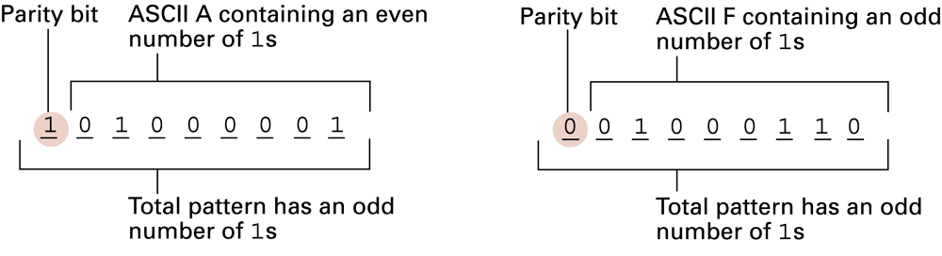
The ASCII codes for the letters A and F adjusted for odd parity

Slide 78
An error-correcting code
Hamming distance (of two bit patterns):
Number of bits in which the patterns differ.
Example:
Hamming(000000, 001111) = 4
Hamming(10101100, 01100100) = 3

Slide 79
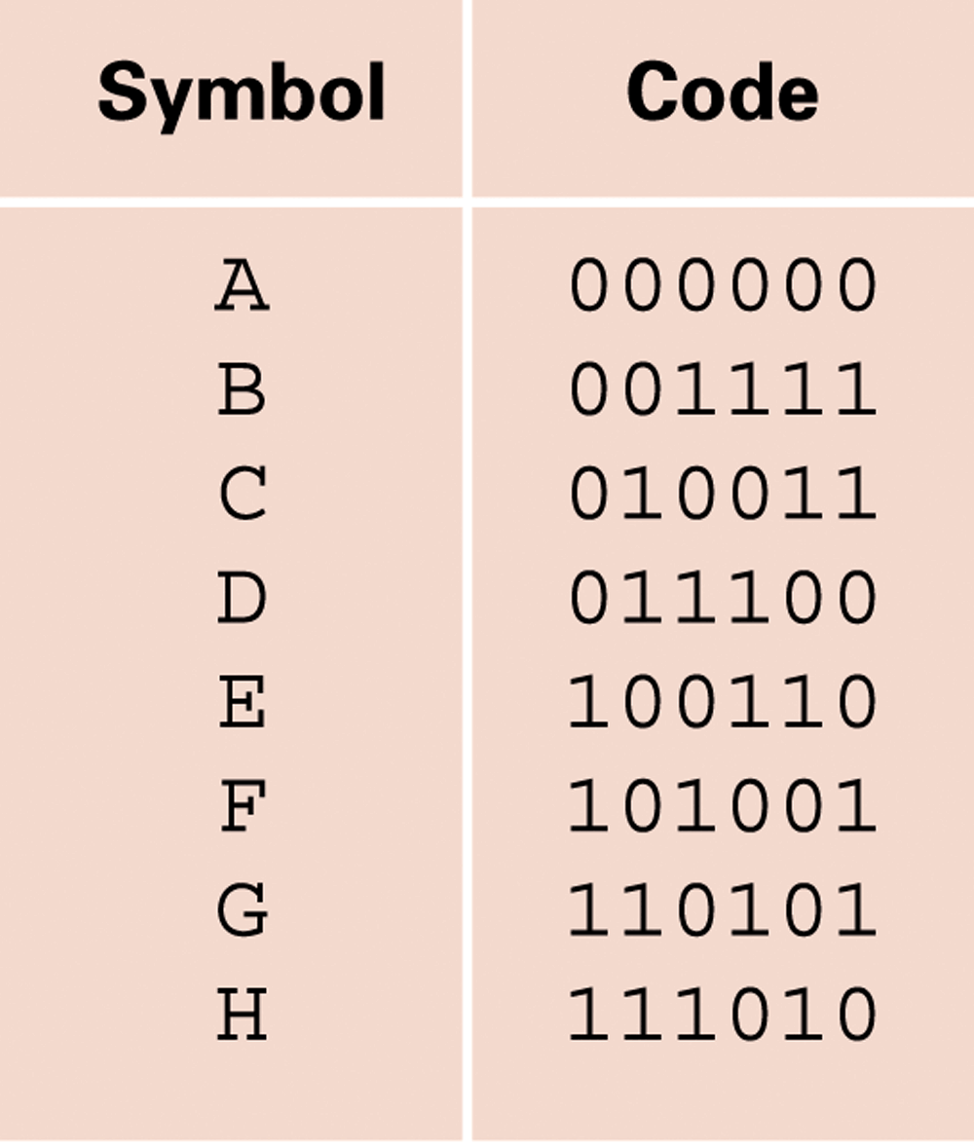
An error-correcting code
Notes:
Hamming distance

Slide 80
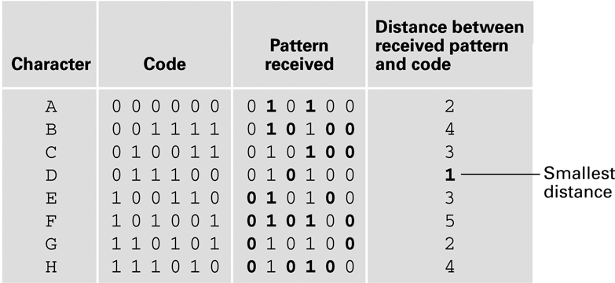
Decoding the pattern 010100

Slide 81
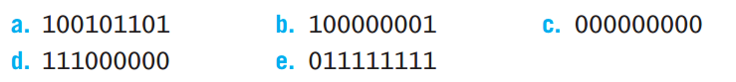
Quiz
The following bytes were originally encoded using odd parity. In which of them do you know that an error has occurred?

Slide 82
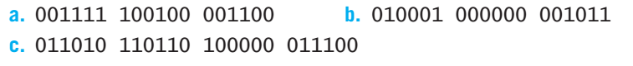
Quiz
Using the error-correcting code presented before, decode the following messages:

Slide 83
Quiz
Construct a code for the characters A, B, C, D using bit patterns of length five so that the Hamming distance between any two patterns is at least three.

Slide 84
Mass Storage

Slide 85
Mass Storage
On-line versus off-line
Typically larger than main memory
Typically less volatile than main memory
Typically slower than main memory
Typically lower cost than main memory

Slide 86
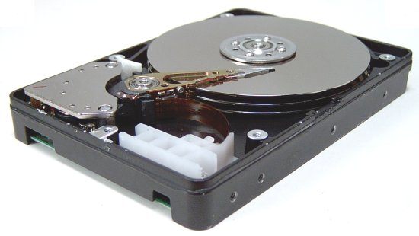
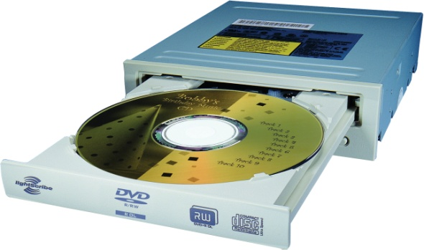
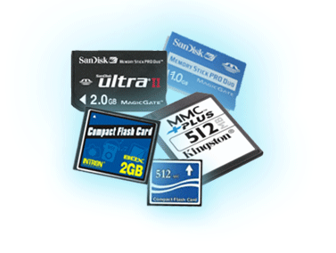
Mass Storage Systems
Magnetic Systems
Disk
Tape
Optical Systems
CD
DVD
Flash Technology
Flash Drives
Secure Digital (SD) Memory Card
Notes:
SSD: Solid-state disks

Slide 87
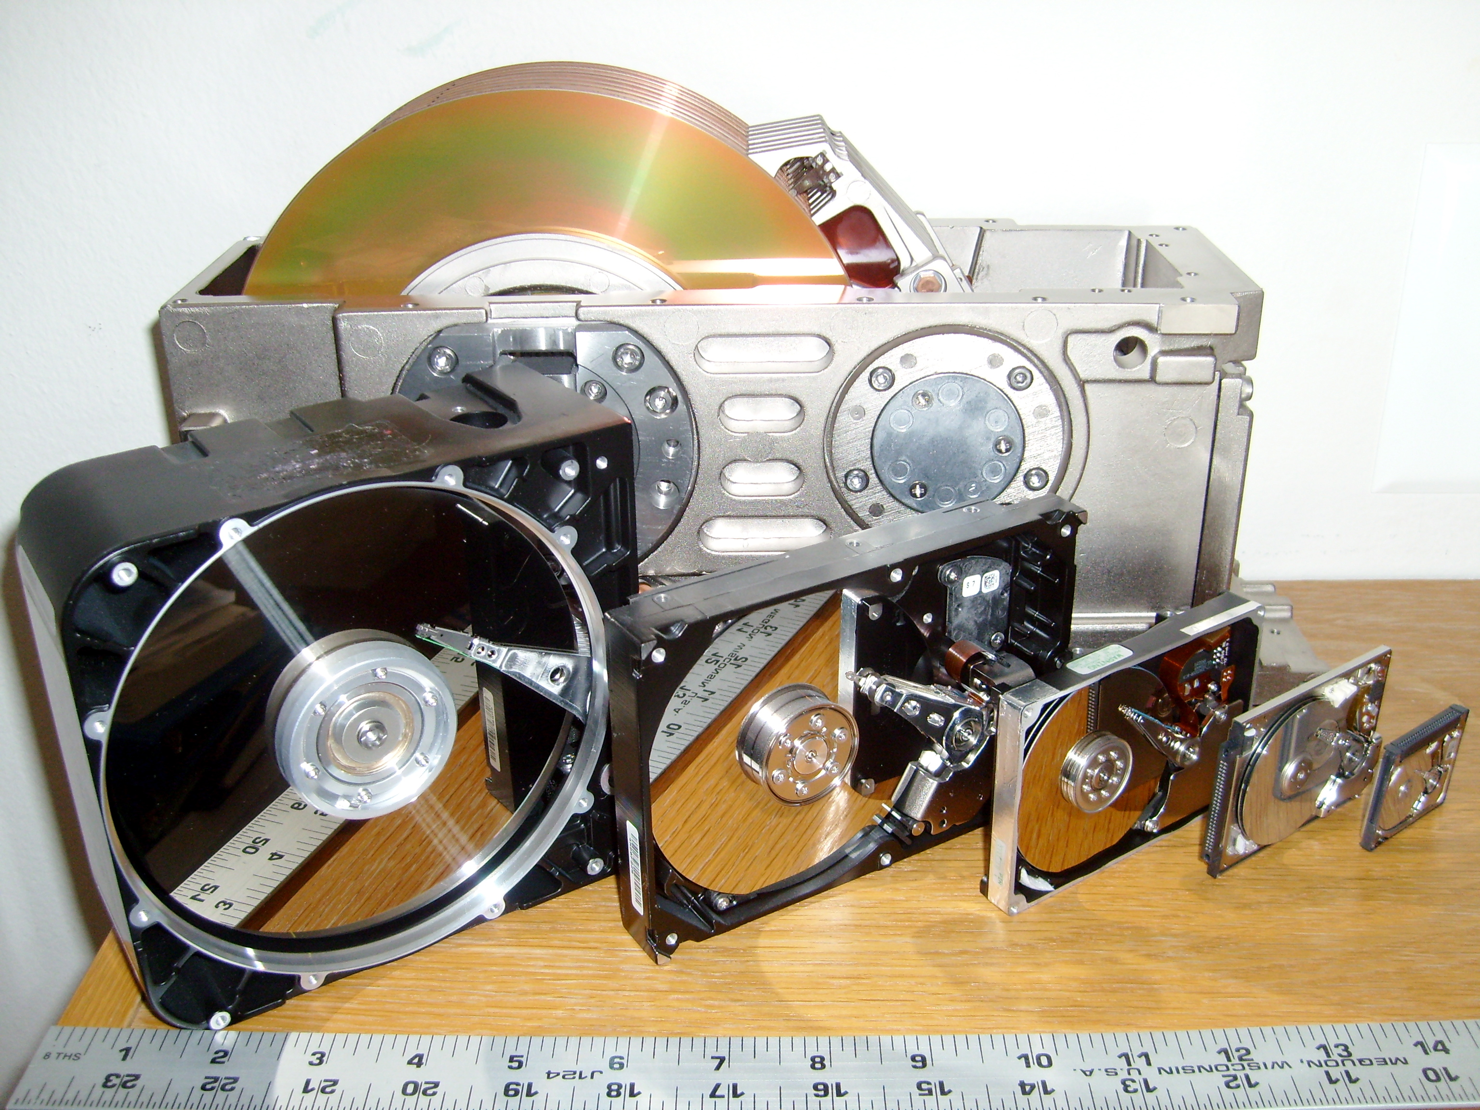
Source: Wikipedia

Slide 88
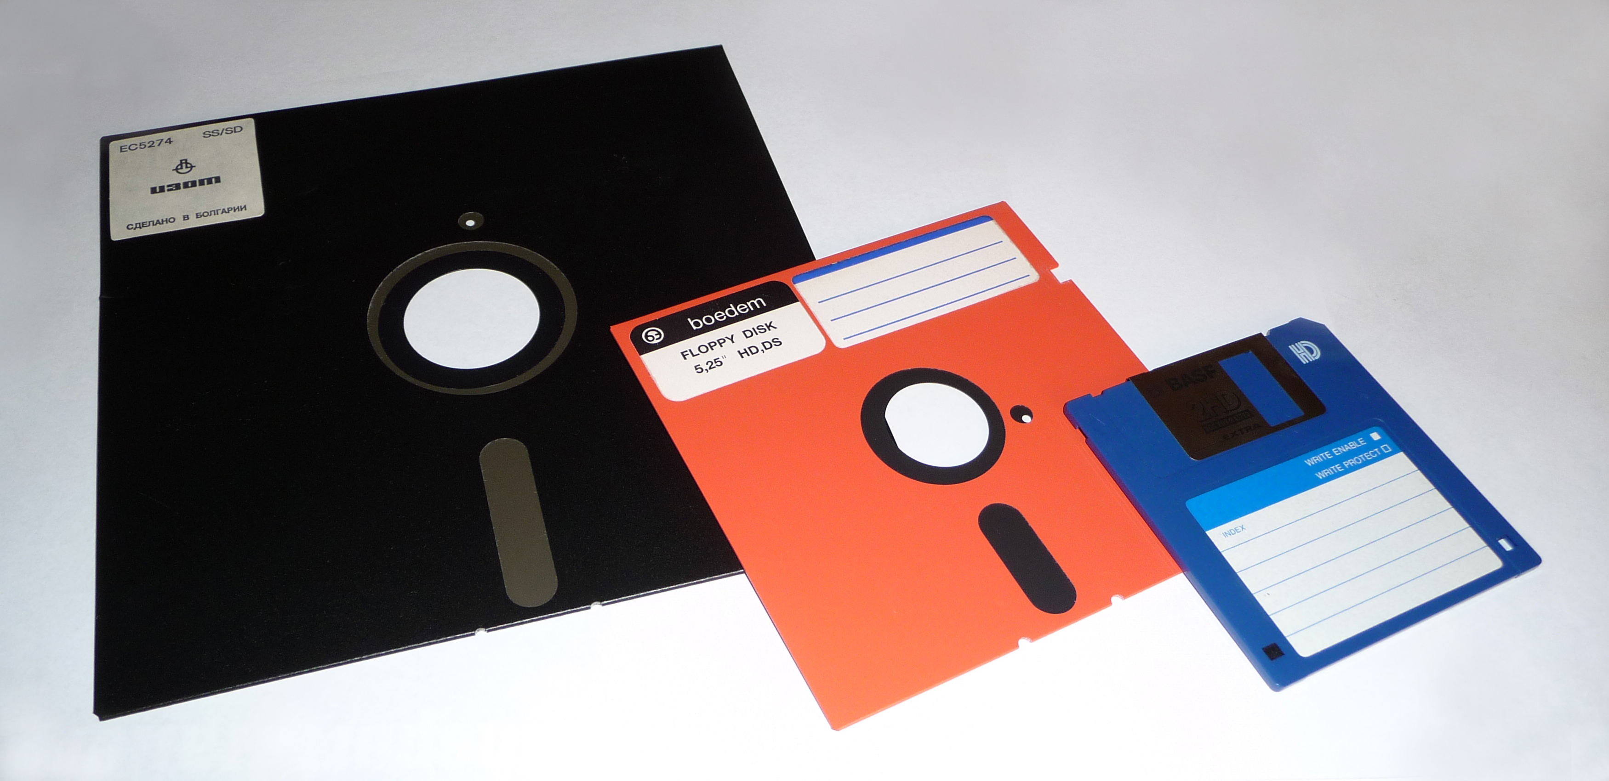
Source: Wikipedia

Slide 89
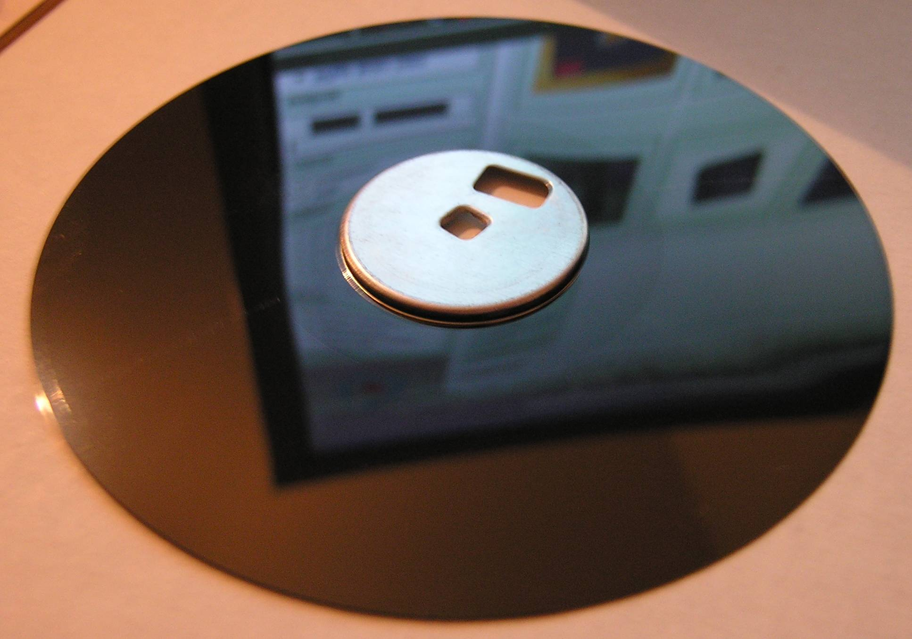
Source: Wikipedia

Slide 90
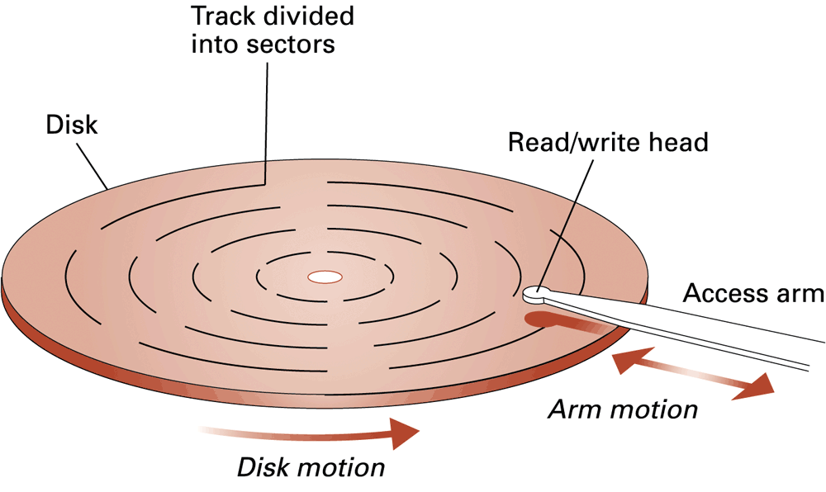
A magnetic disk storage system

Slide 91
A magnetic disk storage system
Data stored on a spinning disk
Disk divided into concentric rings (sectors)
Read/write head moves from one ring to another while disk spins
Access time depends on
Time to move head to correct sector
Time for sector to spin to data location
Fixed number of sectors are placed in a track.

Slide 92
A magnetic disk storage system
Seek time
Time needed to position the read/write head over the correct track
Latency
Time for the beginning of the desired sector to rotate under the read/write head
Transfer time
Time for the entire sector to pass under the read/write head and have its contents read into or written from memory

Slide 93
A magnetic disk storage system
Given:
Rotation speed = 7,200 rev/min=120 rev/sec = 8.33 msec/rev
Arm movement time = 0.02 msec to move to an adjacent track
On average, the read/write head must move about 300 tracks
Number of tracks/surface = 1,000
Number of sectors/track = 64
Number of bytes/sector = 1,024
Seek time
Best case = 0 msec;
Worst case = 999*0.02=19.98 msec
Average case = 300*0.02 = 6 msec

Slide 94
A magnetic disk storage system
Given:
Rotation speed = 7,200 rev/min=120 rev/sec = 8.33 msec/rev
Arm movement time = 0.02 msec to move to an adjacent track
On average, the read/write head must move about 300 tracks
Number of tracks/surface = 1,000
Number of sectors/track = 64
Number of bytes/sector = 1,024
Latency
Best case = 0 msec;
Worst case = 8.33 msec
Average case = 4.17 msec

Slide 95
A magnetic disk storage system
Given:
Rotation speed = 7,200 rev/min=120 rev/sec = 8.33 msec/rev
Arm movement time = 0.02 msec to move to an adjacent track
On average, the read/write head must move about 300 tracks
Number of tracks/surface = 1,000
Number of sectors/track = 64
Number of bytes/sector = 1,024
Transfer time
1/64 * 8.33 msec = 4.17 msec

Slide 96
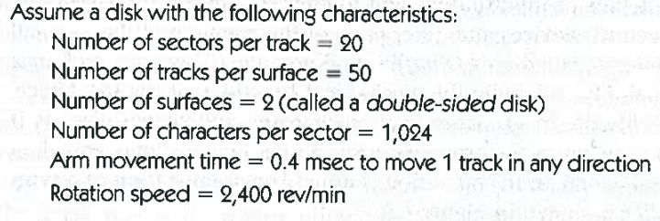
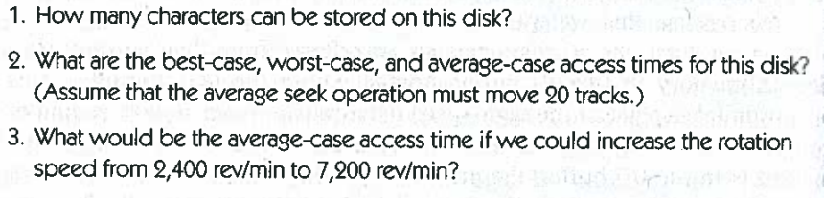

Slide 97
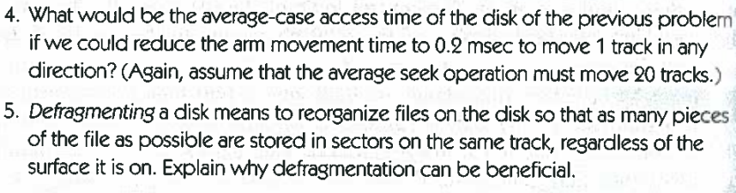

Slide 98
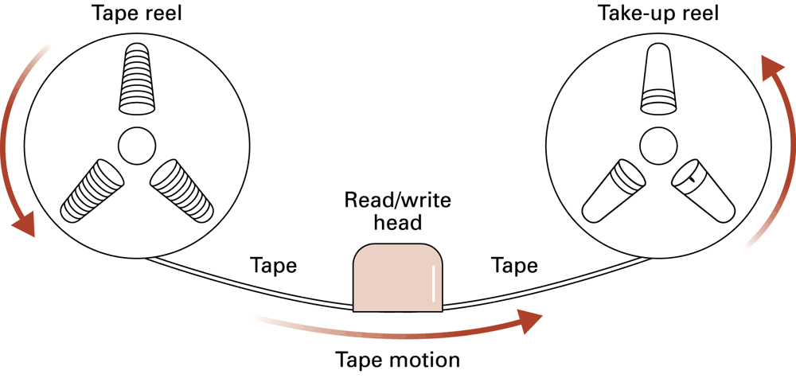
Magnetic tape storage

Slide 99
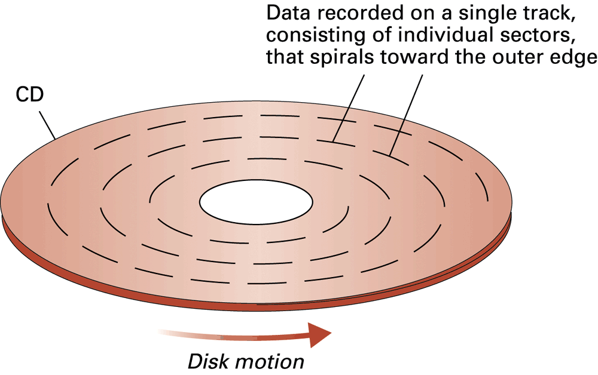
CD storage

Slide 100
Files
File: A unit of data stored in mass storage system
Fields and keyfields
Physical record versus Logical record
Buffer: A memory area used for the temporary storage of data (usually as a step in transferring the data)

Slide 101
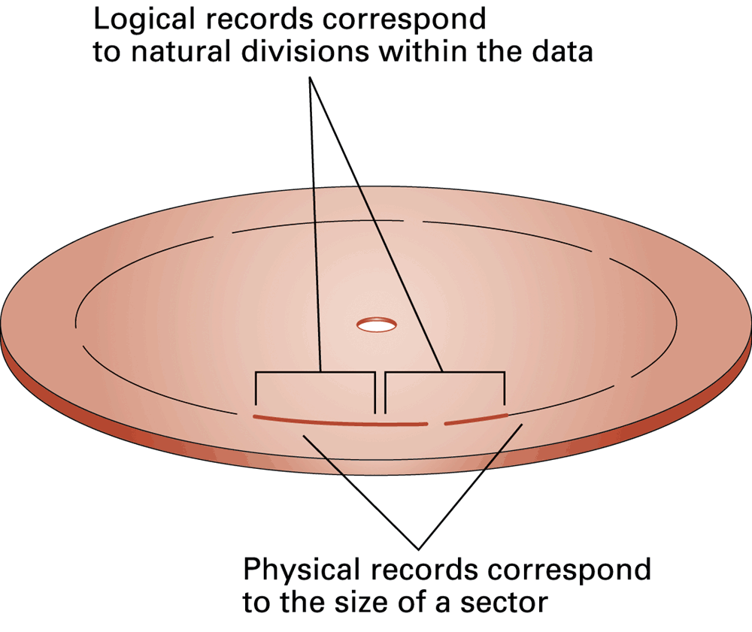
Logical records versus physical records on a disk

